Slide 1
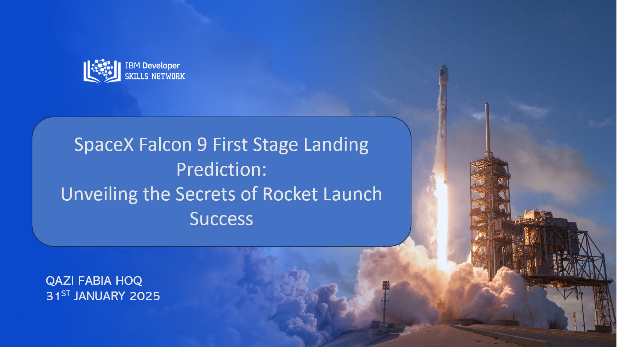


Slide 2

Outline
Executive Summary
Introduction
Methodology
Results
Conclusion
Appendix

Slide 3
Executive Summary
Summary of methodologies
Data Collection through API
Data Collection with Web Scraping
Data Wrangling
Exploratory Data Analysis with SQL
Exploratory Data Analysis with Data Visualization
Interactive Visual Analytics with Folium
Machine Learning Prediction
Summary of all results
Exploratory Data Analysis result
Interactive analytics in screenshots
Predictive Analytics result

Slide 4
Introduction
Project Background
Space X advertises Falcon 9 rocket launches at a cost of $62 million, a significant reduction compared to other providers, who charge upwards of $165 million per launch. A key factor in this cost savings is SpaceX's ability to reuse the first stage of the rocket. By predicting whether the first stage will successfully land, it becomes possible to estimate the overall cost of a launch. This information could be valuable for potential competitors aiming to bid against SpaceX for future rocket launches. The goal of this project is to build a machine learning pipeline to predict the success of the first stage landing.
Business Problems
What are the key factors that influence the success of a rocket landing?
How do different features interact to affect the likelihood of a successful landing?
What operational conditions must be met to ensure the success of the landing program?

Slide 5


Slide 6
Methodology
Data Collection Approach: Data was obtained through the SpaceX API and web scraping from Wikipedia.
Data Processing: Cleaning and structuring of the dataset were conducted to ensure consistency.
Feature Encoding: Categorical variables were transformed using one-hot encoding.
Exploratory Data Analysis (EDA): Visualizations and SQL queries were used to analyze trends and patterns.
Interactive Visualizations: Folium and Plotly Dash were utilized for dynamic data exploration.
Predictive Modeling: Classification algorithms were applied to assess landing success.
Model Optimization: Techniques for building, fine-tuning, and evaluating classification models were explored.

Slide 7
Data Collection
The data was collected using various methods
Data collection was conducted using a GET request to the SpaceX API.
The response content was decoded into JSON format using the .json() function and converted into a Pandas DataFrame with .json_normalize().
The data was then cleaned, missing values were identified, and necessary imputations were performed.
Additionally, web scraping was carried out using BeautifulSoup to extract Falcon 9 launch records from Wikipedia.
The extracted launch records, originally in an HTML table format, were parsed and transformed into a Pandas DataFrame for further analysis.

Slide 8
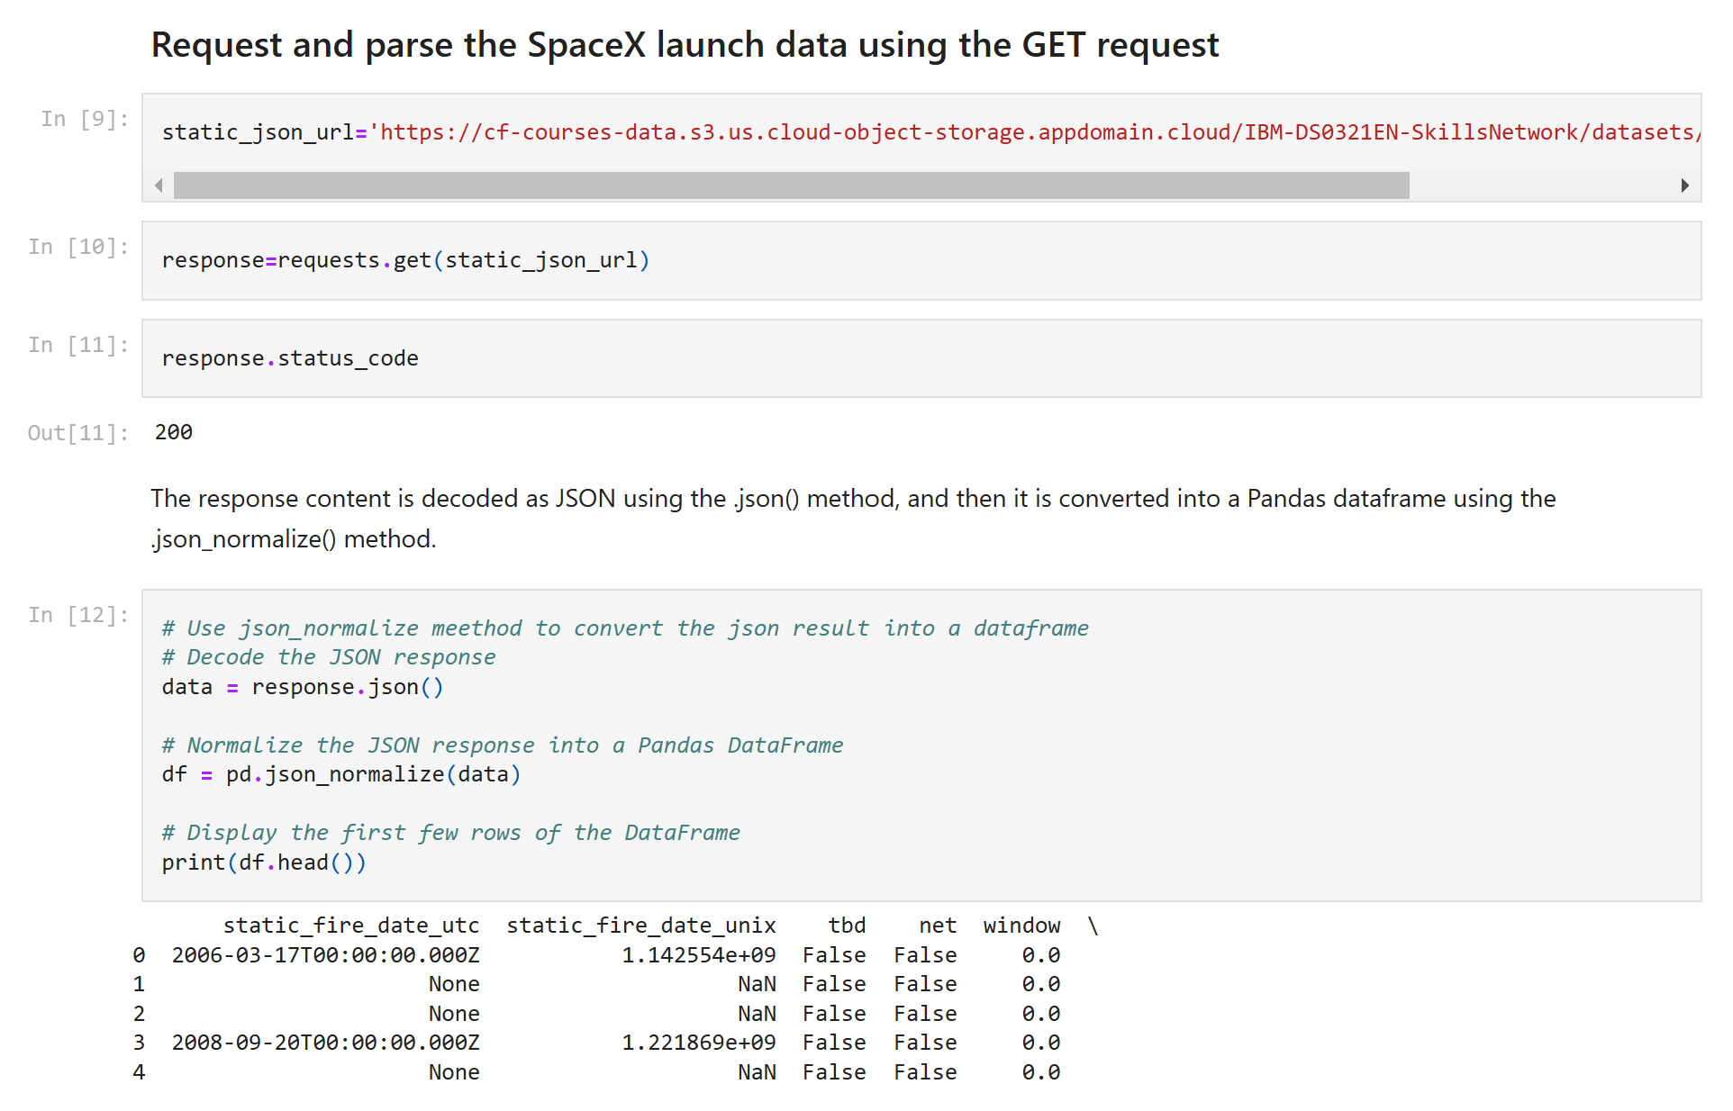
Data Collection – SpaceX API
A GET request to the SpaceX API was used to collect data, which was then cleaned, processed, and formatted through basic data wrangling.
The link to the notebook is https://github.com/qazifabiahoq/Space-X_Landing-Prediction_CAPSTONE_PROJECT_IBM/blob/main/notebooks_dashapp/data_collection_api.ipynb

Slide 9
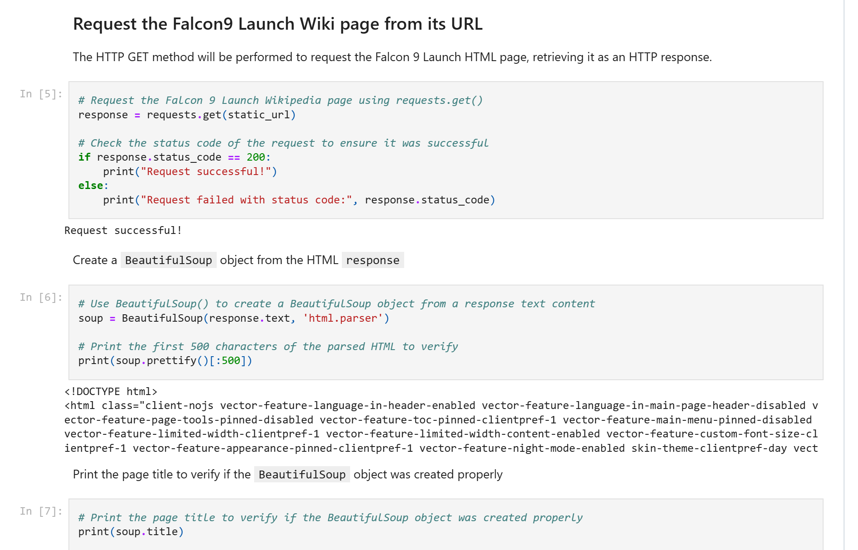
Data Collection – Web Scraping
Web scraping was applied to extract Falcon 9 launch records using BeautifulSoup.
The table was parsed and converted into a Pandas DataFrame.
The link to the notebook is https://github.com/qazifabiahoq/Space-X_Landing-Prediction_CAPSTONE_PROJECT_IBM/blob/main/notebooks_dashapp/web_scrapping.ipynb

Slide 10

Data Wrangling
Conducted exploratory data analysis and determined training labels.
Calculated the number of launches at each site using the .value_counts() method on the LaunchSite column.
Analyzed the number and occurrence of each orbit using .value_counts() on the Orbit column.
Evaluated mission outcomes by applying .value_counts() to the Outcome column, assigning results to landing_outcomes.
Created landing outcome labels from the Outcome column and exported the results to a CSV file.
The link to the notebook is https://github.com/qazifabiahoq/Space-X_Landing-Prediction_CAPSTONE_PROJECT_IBM/blob/main/notebooks_dashapp/wrangling.ipynb

Slide 11
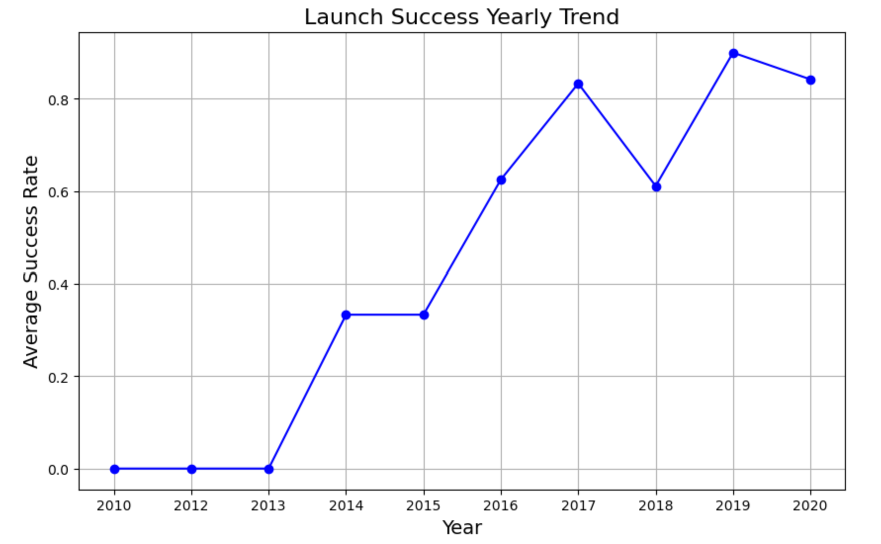
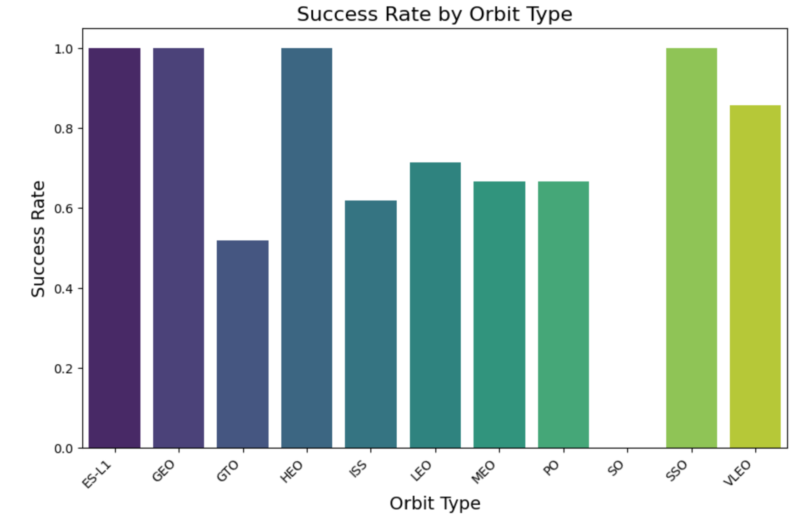
EDA with Data Visualization
Key relationships were analyzed through visualizations. The success rate of each orbit type was examined, and yearly launch success trends were plotted. Scatter plots explored the impact of payload mass on orbit type and launch site. Additionally, the relationship between flight number and launch site was visualized.
The link to the notebook is https://github.com/qazifabiahoq/Space-X_Landing-Prediction_CAPSTONE_PROJECT_IBM/blob/main/notebooks_dashapp/data_analysis_visualizations.ipynb

Slide 12
EDA with SQL
Loaded the SpaceX dataset into an SQL database using SQLAlchemy within Jupyter Notebook..
Applied EDA with SQL to extract insights, including:
Unique launch site names.
Total payload mass carried by NASA (CRS) missions.
Average payload mass for booster version F9 v1.1.
Total count of successful and failed missions.
Failed landings on drone ships, including booster versions and launch sites.
The link to the notebook is https://github.com/qazifabiahoq/Space-X_Landing-Prediction_CAPSTONE_PROJECT_IBM/blob/main/notebooks_dashapp/EDA_SQL.ipynb

Slide 13
Geospatial Analysis with Folium
Marked all launch sites and added map objects such as markers, circles, and lines to indicate launch success or failure.
Assigned launch outcomes to binary classes: 0 for failure and 1 for success.
Used color-labeled marker clusters to identify launch sites with relatively high success rates.
Calculated distances between launch sites and nearby features, addressing questions such as:
Are launch sites near railways, highways and coastlines?
Do launch sites maintain a certain distance from cities?
The link to the notebook is https://github.com/qazifabiahoq/Space-X_Landing-Prediction_CAPSTONE_PROJECT_IBM/blob/main/notebooks_dashapp/follium_map_launchsite.ipynb

Slide 14
Interactive Dashboard with Plotly Dash
Built an interactive dashboard using Plotly Dash.
Plotted pie charts to show the total number of launches by each site.
Created scatter plots to visualize the relationship between outcome and payload mass (kg) for different booster versions.
The link to the notebook is https://github.com/qazifabiahoq/Space-X_Landing-Prediction_CAPSTONE_PROJECT_IBM/blob/main/notebooks_dashapp/spacex_dash_app.py

Slide 15
Predictive Analysis
Loaded the data using NumPy and Pandas, transformed it, and split it into training and testing sets.
Built various machine learning models and tuned hyperparameters using GridSearchCV.
Used accuracy as the evaluation metric, improving the model through feature engineering and algorithm tuning.
Identified the best-performing classification model.
The link to the notebook is https://github.com/qazifabiahoq/Space-X_Landing-Prediction_CAPSTONE_PROJECT_IBM/blob/main/notebooks_dashapp/Machine%20Learning%20Prediction.ipynb

Slide 16
Results
Presented exploratory data analysis (EDA) results.
Included interactive analytics demo with screenshots.
Showcased predictive analysis results.

Slide 17


Slide 18
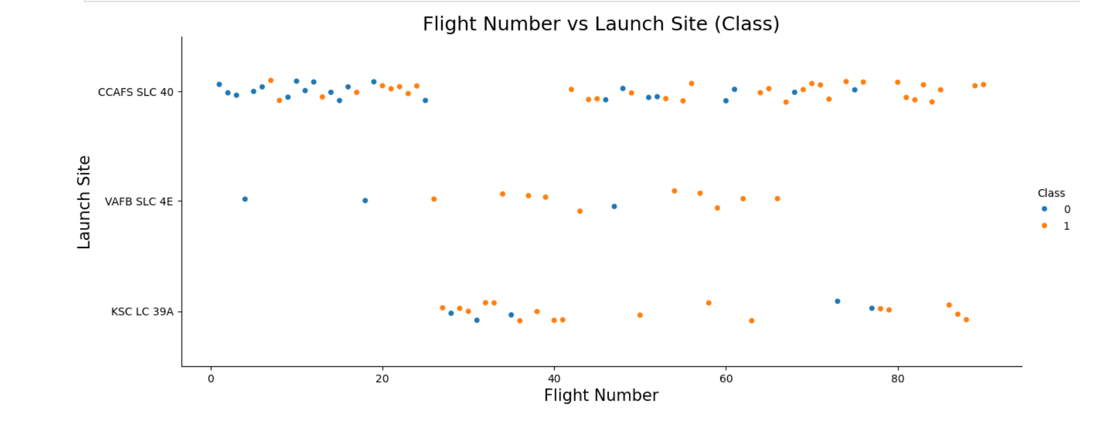
Flight Number vs. Launch Site
CCAFS SLC 40 is the most active site, with a high density of launches and a mix of successful and unsuccessful landings. VAFB SLC 4E and KSC LC 39A have fewer launches, with KSC LC 39A showing a lower frequency beyond flight number 40.
The analysis shows that as the number of launches increases at a site, the success rate also improves, with more Class 1 (successful) landings observed as flight numbers rise.

Slide 19
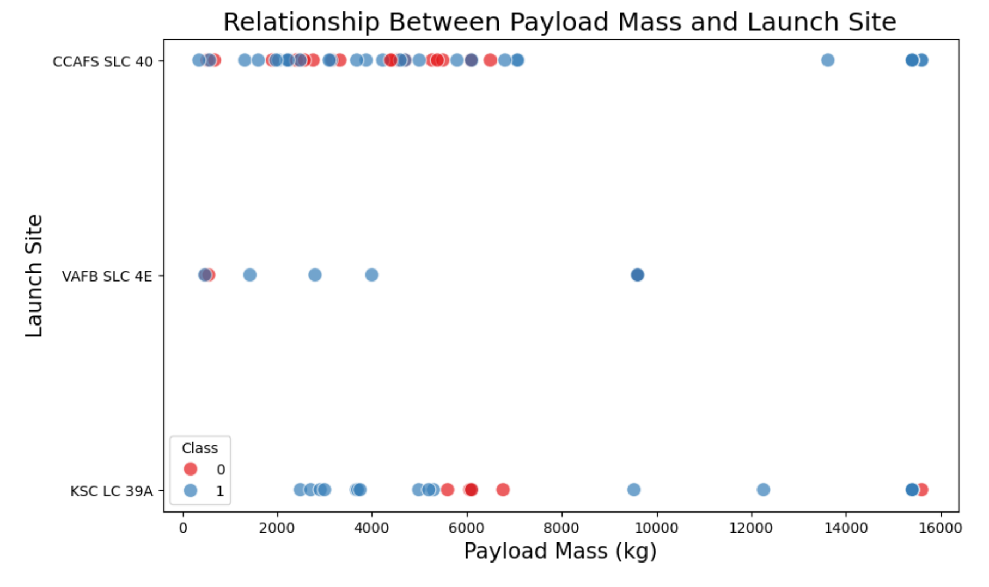
Payload vs. Launch Site
VAFB SLC 4E has relatively fewer launches compared to other sites and does not support payloads greater than 10,000 kg, suggesting it may be specialized for lighter payloads.
CCAFS SLC 40 and KSC LC 39A handle a broader range of payloads, including those above 10,000 kg.
The analysis shows that as payload mass increases, the success rate for launches at these sites also tends to be higher.

Slide 20

Success Rate vs. Orbit Type
Highest Success Rate (1.0): ES-L1, GEO, and HEO orbits show perfect success with a 100% success rate.
Near-Perfect Success Rate (~1.0): SSO orbit has nearly perfect success, followed by VLEO with a high success rate around 0.9.
Moderate Success Rate: LEO, MEO, and PO orbits have moderate success rates (0.7 to 0.6).
Lowest Success Rate (0.5): GTO orbit has the lowest success rate at 0.5, indicating a higher failure rate.
No Success: SO orbit has a success rate of 0, with no successful missions.

Slide 21
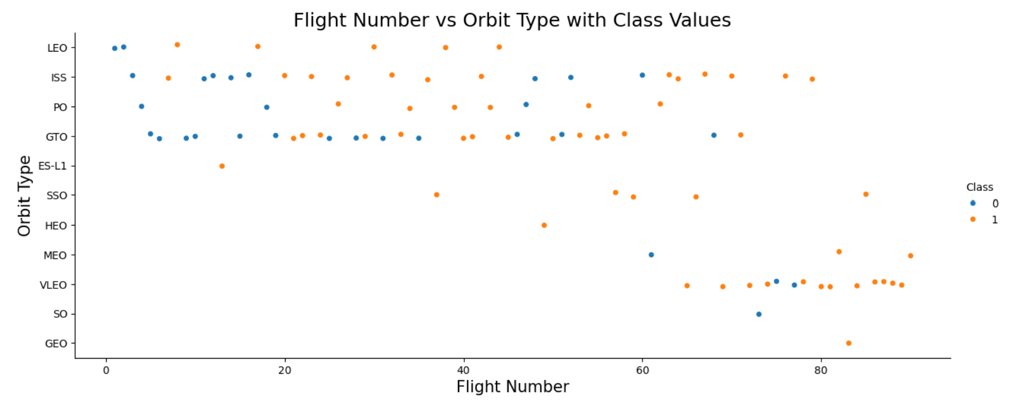
Flight Number vs. Orbit Type
The plot below illustrates the relationship between flight number and orbit type. It reveals that in the LEO orbit, success tends to increase with the number of flights, while in the GTO orbit, no such relationship is observed between flight number and success rate.

Slide 22
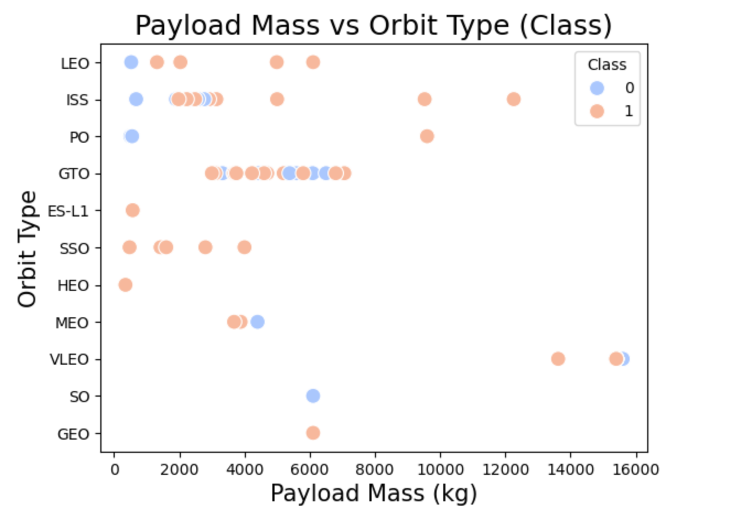
Payload vs. Orbit Type
For Polar, LEO, and ISS orbits, heavier payloads tend to have a higher success rate in landings.
In GTO, there is no clear relationship between payload mass and landing success, as both successful and unsuccessful landings are observed across a wide range of payloads.

Slide 23
Launch Success Yearly Trend
The success rate of SpaceX launches has steadily increased since 2013, reflecting continuous improvements in technology and operations, especially between 2013 and 2020.

Slide 24
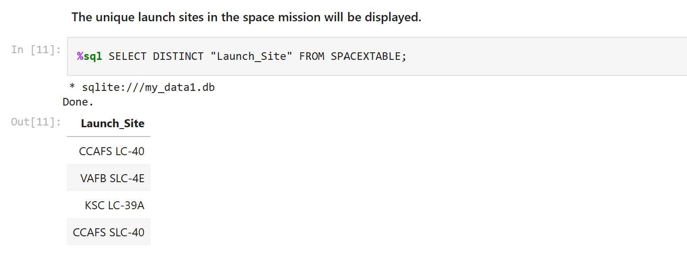
All Launch Site Names
The DISTINCT SQL clause was used to display only the unique launch sites from the SpaceX data.

Slide 25
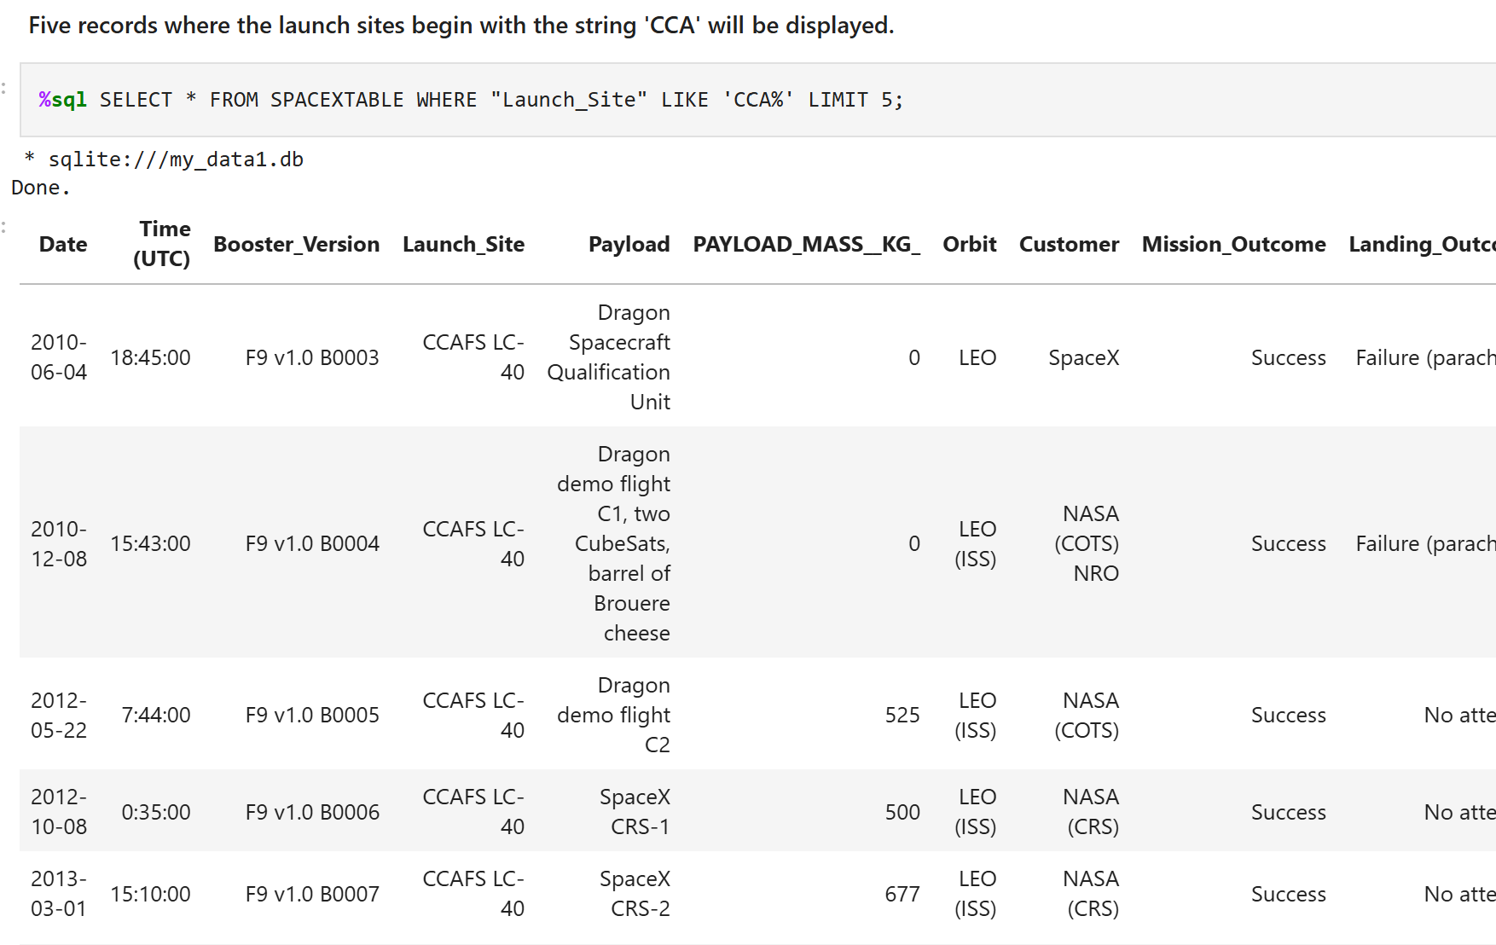
Launch Site Names Begin with 'CCA'
The query above was used to display 5 records where launch sites begin with CCA.

Slide 26
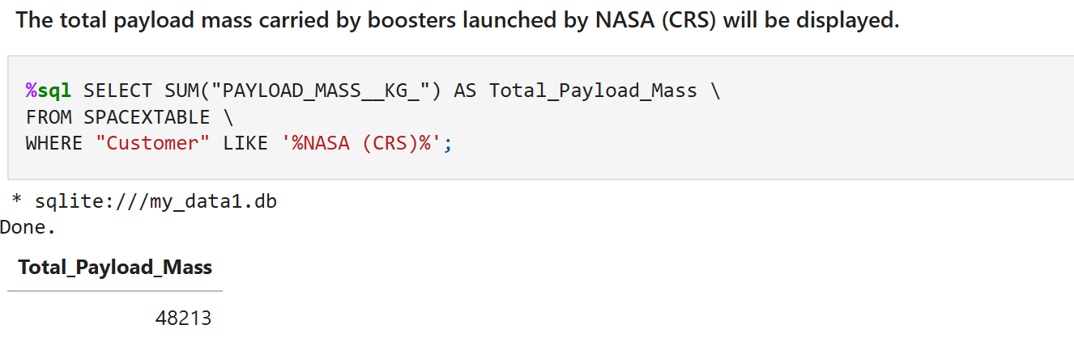
Total Payload Mass
The total payload mass carried by boosters launched by NASA (CRS), totaling 48,213 kg, was calculated using the query below.

Slide 27
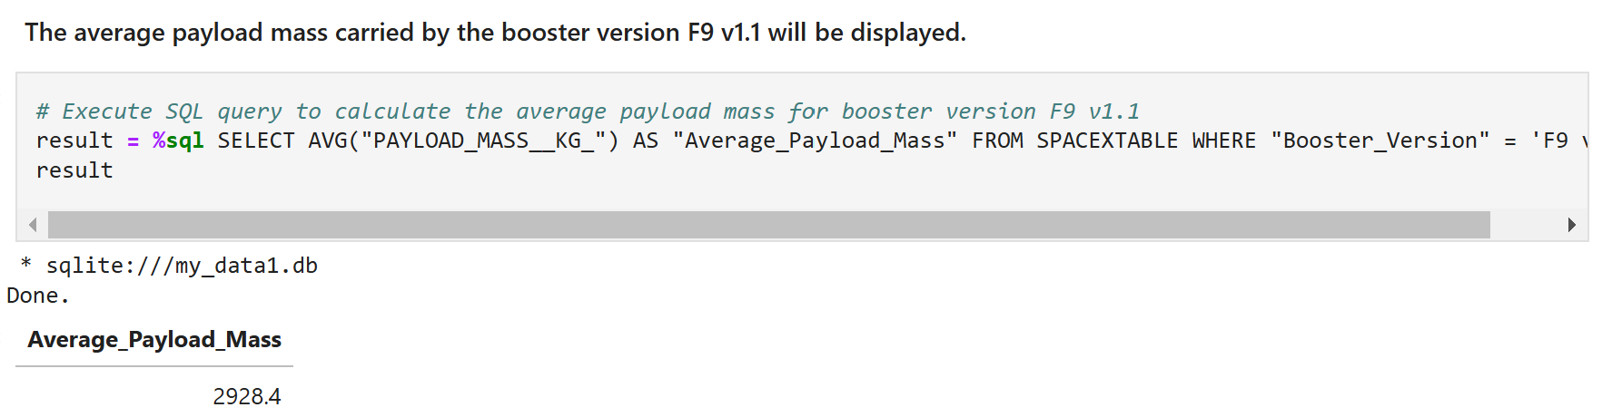
Average Payload Mass by F9 v1.1
The average payload mass carried by the booster version F9 v1.1, calculated to be 2,928.4 kg, was determined.

Slide 28
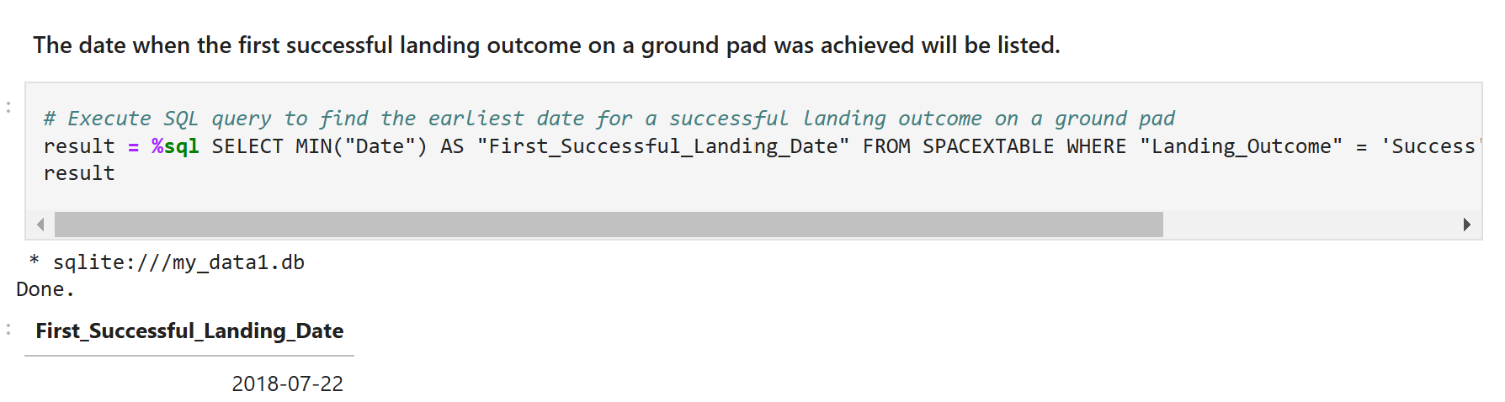
First Successful Ground Landing Date
The first successful landing on a ground pad was on 22nd July 2018.

Slide 29
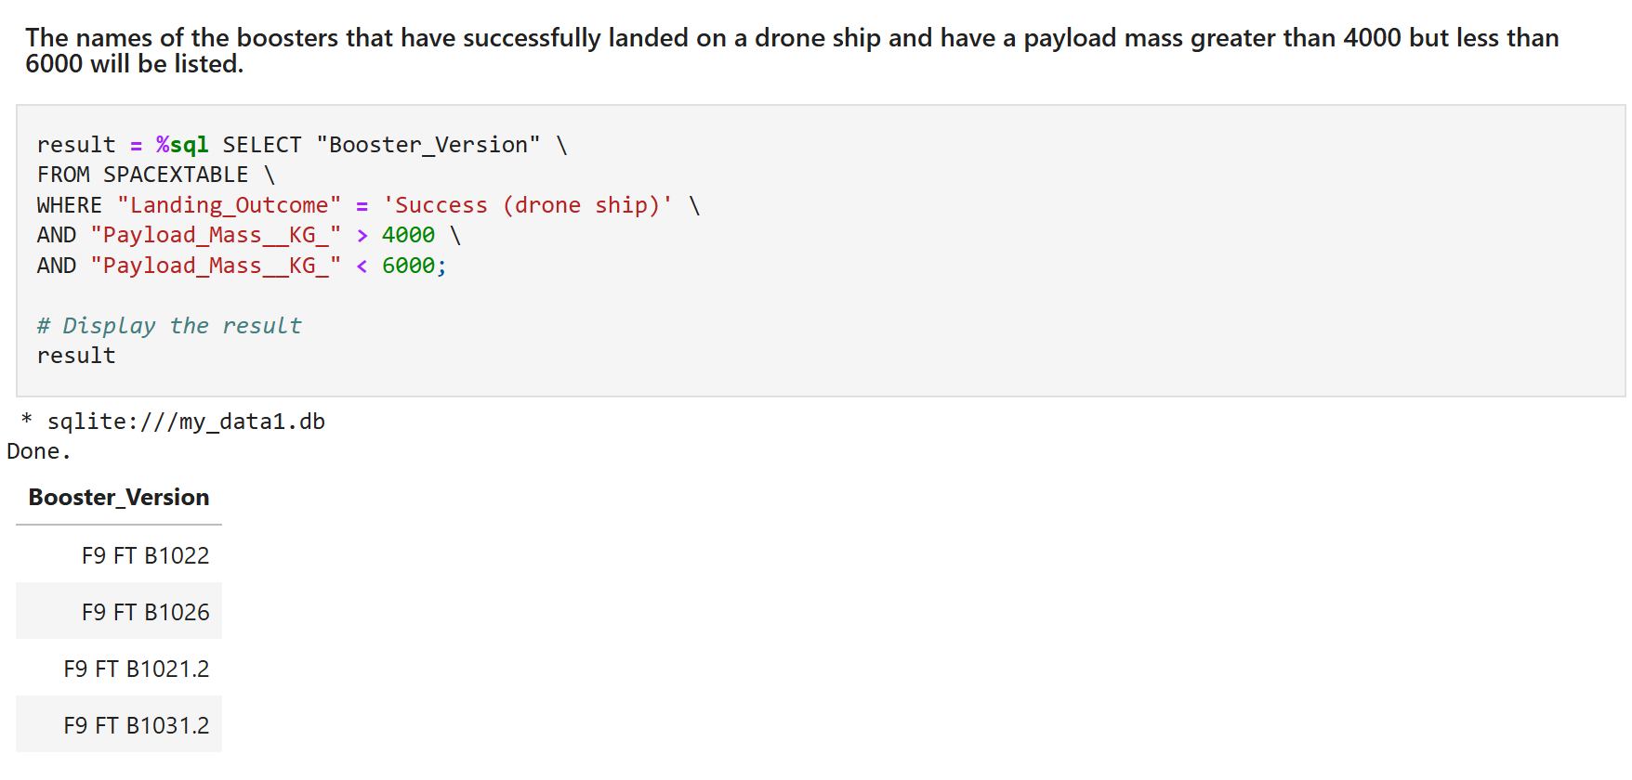
Successful Drone Ship Landing with Payload between 4000 and 6000
The WHERE clause was used to filter for boosters that successfully landed on a drone ship, with an additional AND condition to select successful landings where the payload mass was greater than 4,000 kg but less than 6,000 kg.

Slide 30
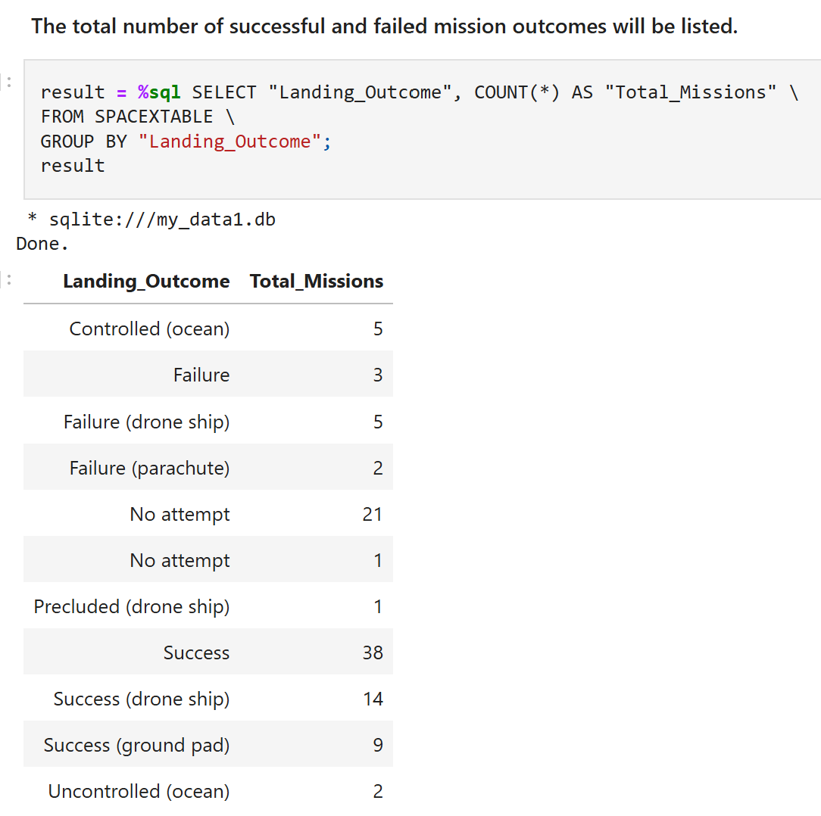
Total Number of Successful and Failed Mission Outcomes
The total number of successful and failed mission outcomes was calculated by using the wildcard '%' to filter for different Landing_Outcome categories, such as controlled ocean landings, drone ship landings, and ground pad landings. This allowed for grouping and counting the outcomes based on success or failure.

Slide 31
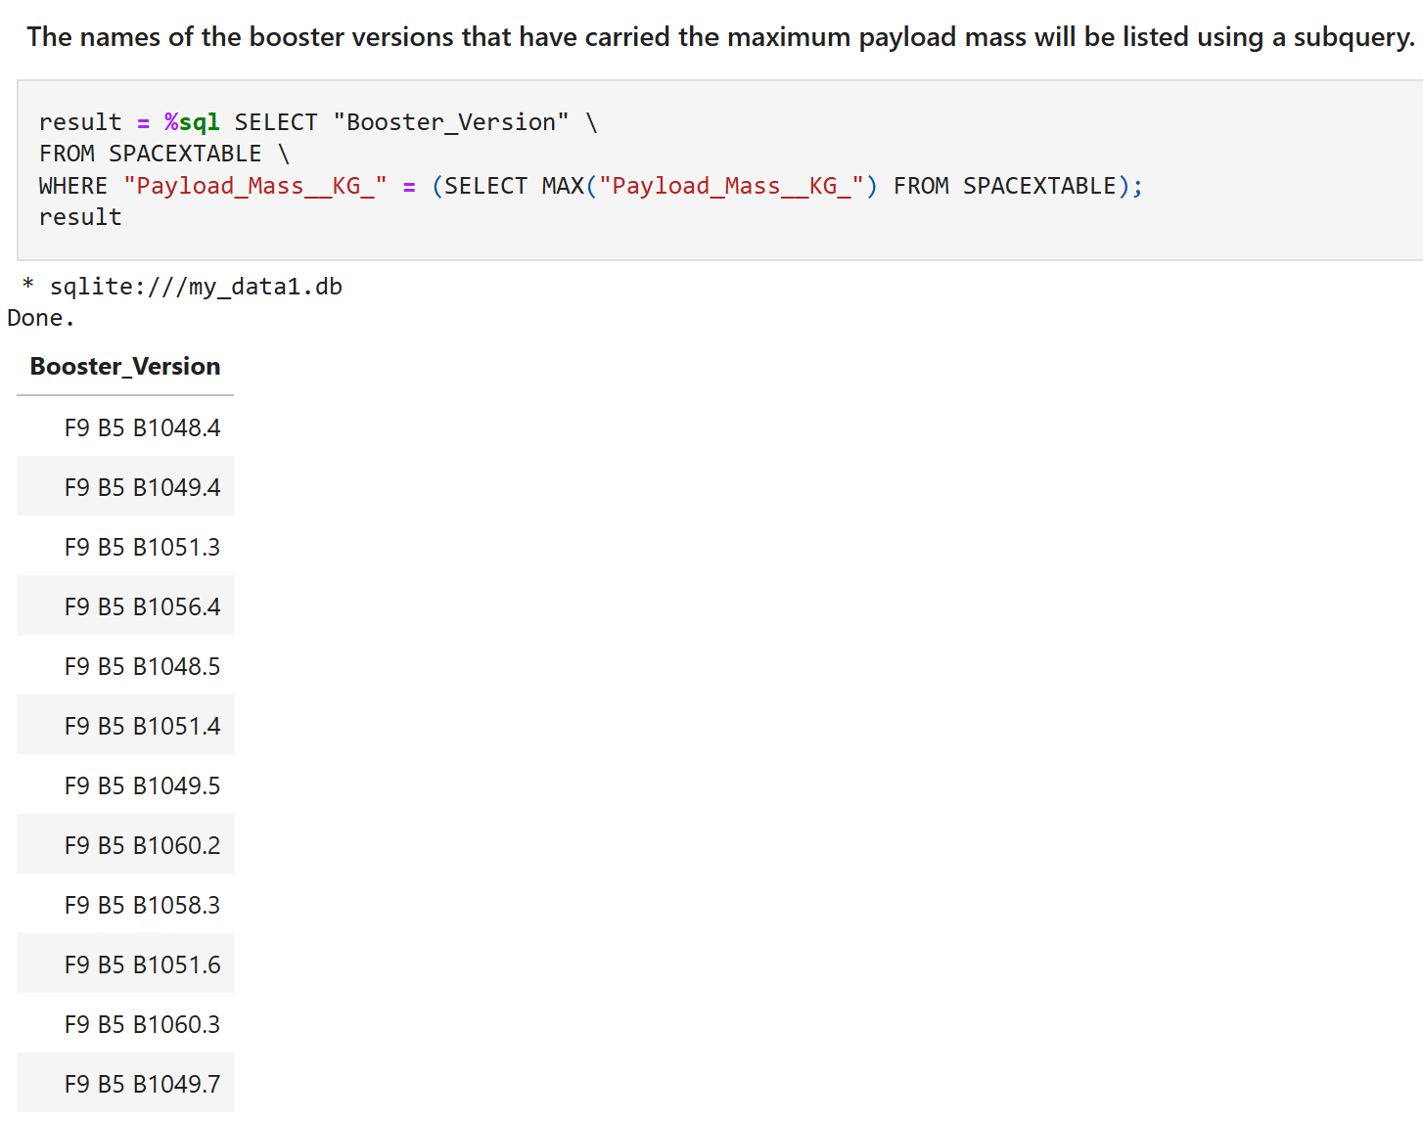
Boosters Carrying The Maximum Payload
The booster that carried the maximum payload was determined using a subquery in the WHERE clause along with the MAX() function.

Slide 32
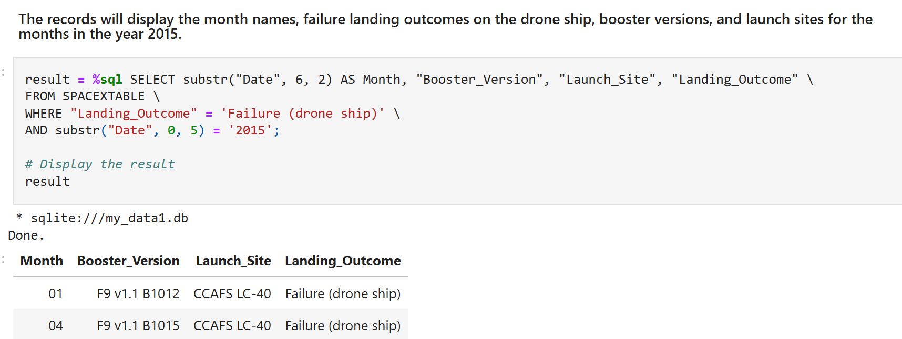
2015 Launch Records
A combination of the WHERE clause, LIKE, AND, and BETWEEN conditions was used to filter for failed landing outcomes on a drone ship, along with their booster versions and launch site names for the year 2015.

Slide 33
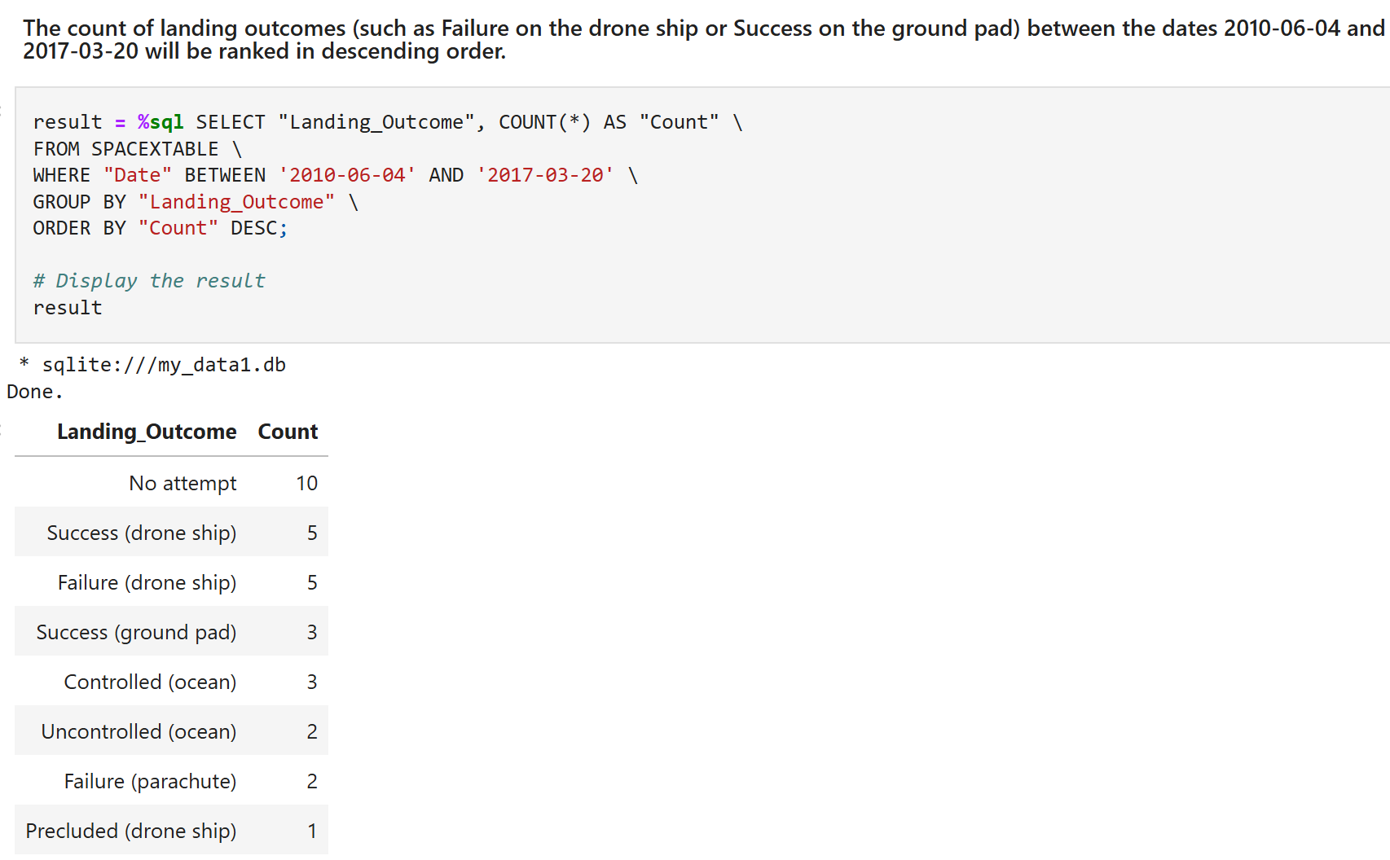
Rank Landing Outcomes Between 2010-06-04 and 2017-03-20
We selected the COUNT of landing outcomes (such as Failure on the drone ship or Success on the ground pad) from the data, using the WHERE clause to filter for landing outcomes between the dates 2010-06-04 and 2017-03-20.
The GROUP BY clause was applied to group the landing outcomes, and the ORDER BY clause was used to rank the grouped outcomes in descending order.

Slide 34


Slide 35
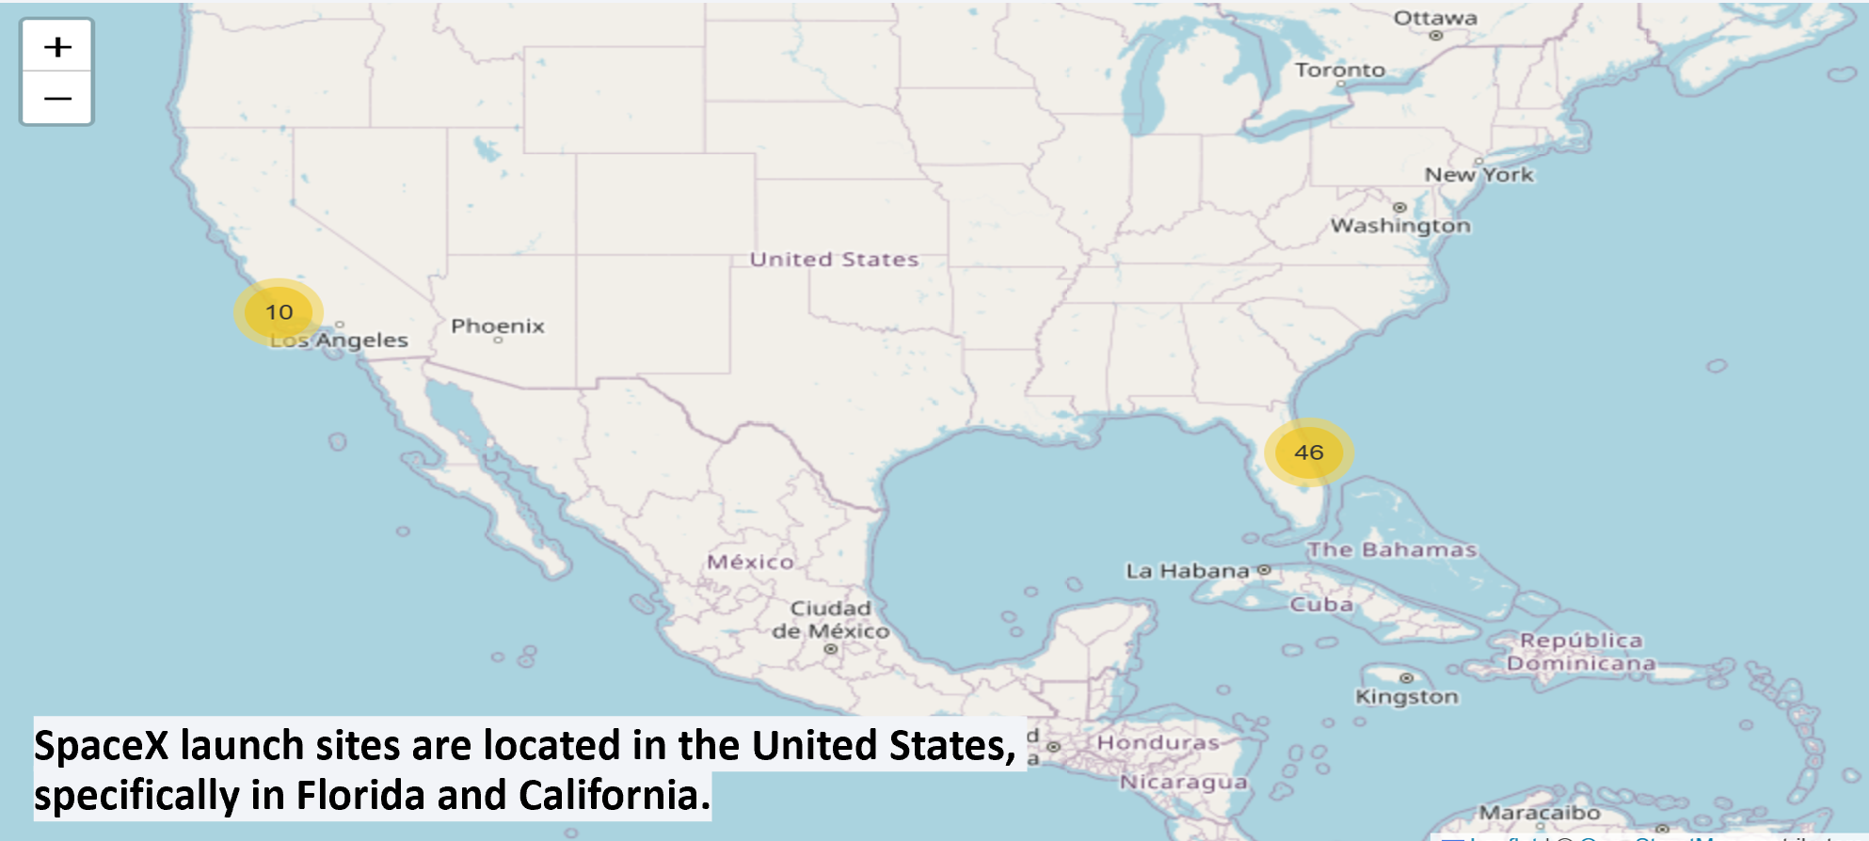
All launch sites

Slide 36
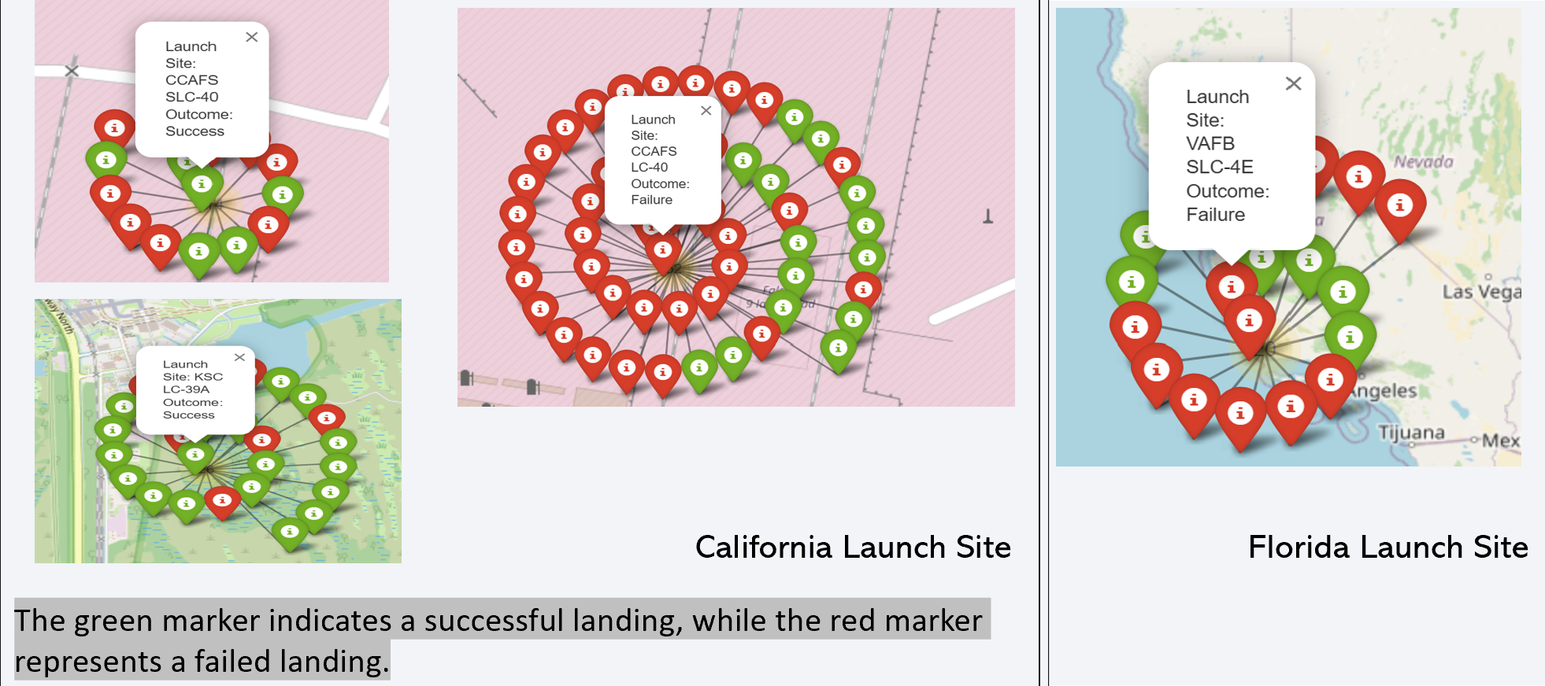
Markers showing launch sites with color labels

Slide 37
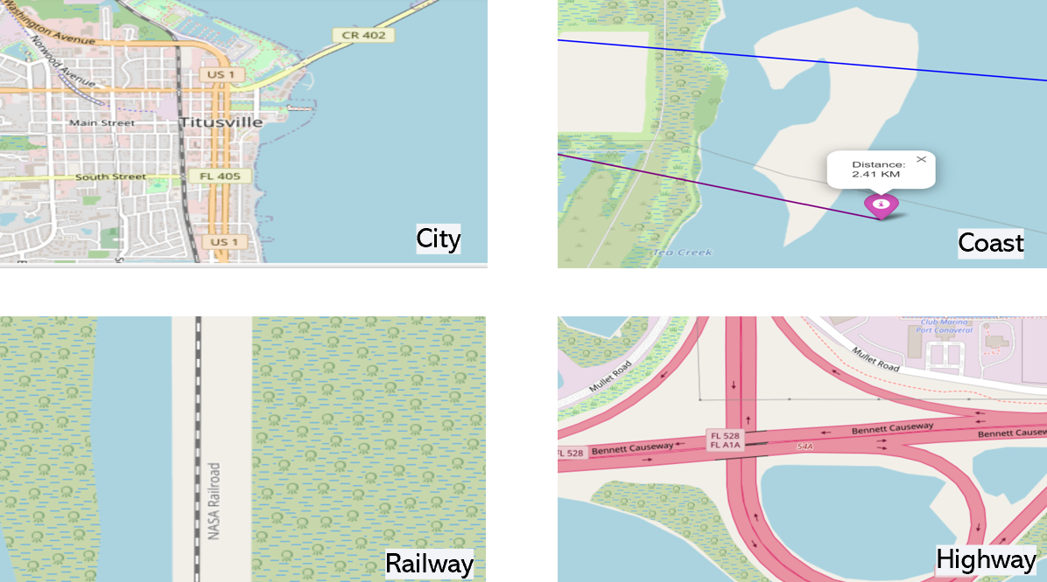
Launch Site distance to landmarks

Slide 38


Slide 39

Pie chart showing the success percentage achieved by each launch site

Slide 40

Pie chart showing the Launch site with the highest launch success ratio

Slide 41

Scatter plot of Payload vs Launch Outcome for all sites, with different payload selected in the range slider

Slide 42


Slide 43
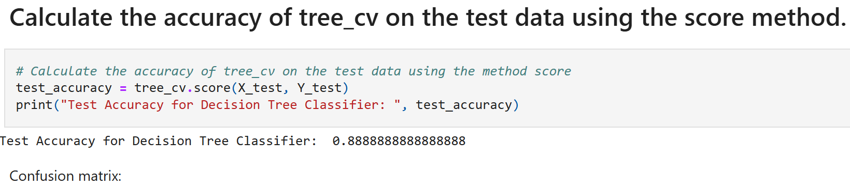
Classification Accuracy
The decision tree classifier is the model with the highest classification accuracy

Slide 44
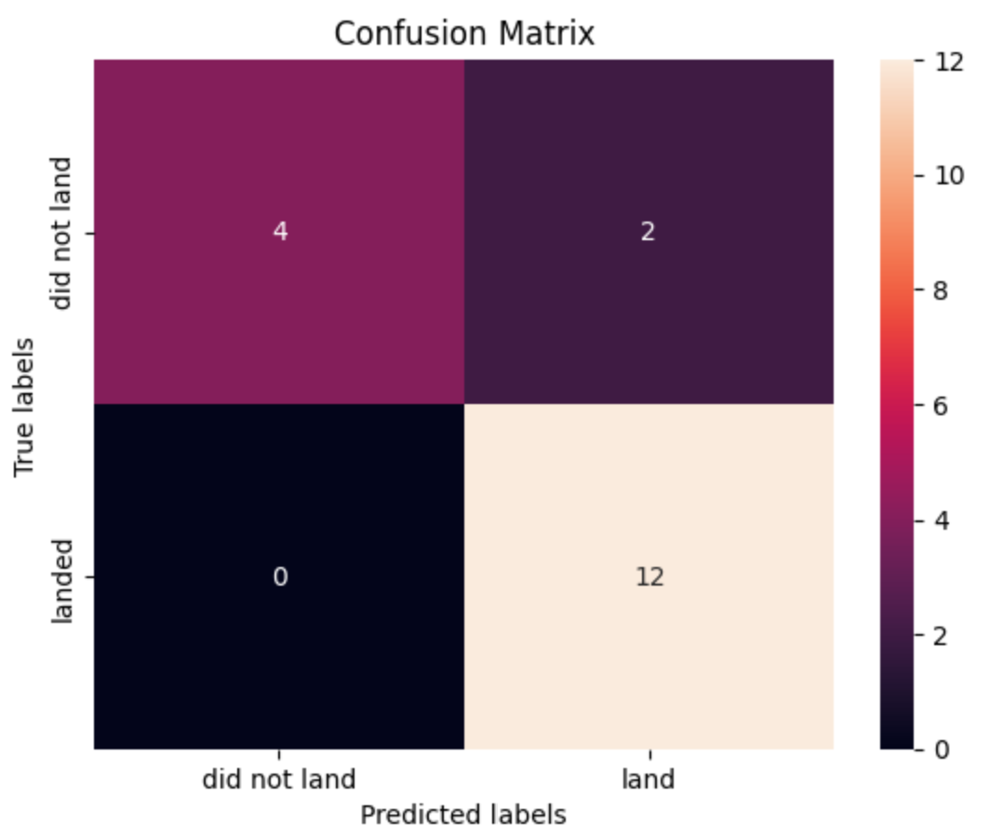
Confusion Matrix
The Decision Tree model is the best performing model, with an excellent confusion matrix. It correctly predicted 12 successful landings (True Positives), 4 failed landings (True Negatives), and had only 2 false positives. Notably, there were no false negatives, indicating the model’s high accuracy in predicting successful landings.

Slide 45
Conclusions
Key Conclusions:
CCAFS SLC 40 is the most active site, VAFB SLC 4E handles lighter payloads, and KSC LC 39A supports a broader range of payloads.
The success rate of SpaceX launches steadily increased from 2013 to 2020, reflecting technological improvements.
ES-L1, GEO, and HEO orbits have 100% success rates, while GTO orbits show the lowest success at 50%.
Heavier payloads generally correlate with higher landing success, especially in Polar, LEO, and ISS orbits.
The larger the flight amount at a launch site, the greater the success rate at that site.
The first successful landing on a ground pad occurred on 22nd July 2018.
The total payload mass for NASA (CRS) missions was 48,213 kg, and the average payload mass for F9 v1.1 was 2,928.4 kg.
KSC LC-39A had the most successful launches of any site.
The Decision Tree model achieved 88% accuracy, with a strong confusion matrix showing 12 True Positives and no False Negatives.

Slide 46


